Slide 1
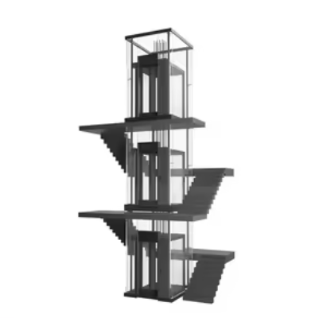
2st model
3-Floors elevator
with one manually-actuated door

Slide 2
3-Floors elevator
In this section, we model a three-floor elevator.
The additional complexities compared to the two-floor case are:
On the middle floor, the elevator is allowed to both descend and ascend.
It is necessary to introduce a button panel indicating to the elevator at which floor it should stop.
Note that in all the automata considered, the alphabet is composed only of the events present in the corresponding automaton.

Slide 3
3-Floors elevator
The following components are then modeled:
The sensor that detects the position of the elevator.
The elevator motor.
The button panel.
Note: The door open/close sensor is not modeled here because it is simpler to initially focus on these three components. This sensor will be implemented later.

Slide 4
3-Floors elevator
FIRST STEP: OUTLINE THE SYSTEM COMPONENTS
SENSORS:
FLOOR PRESENCE SENSORS:
Each floor is endowed with a presence sensor
BUTTON PANEL:
Inside the elevator cabin, a button panel is used to select the destination.
At each floor, a button can be used to call the elevator.
It is assumed that it is impossible to select a new button until the elevator has reached the desired floor selected by the last command.
ACTUATORS:
ELEVATOR MOTOR:
The motor can move the elevator up and down
F3
up
down
F2
F1

Slide 5
3-Floors elevator
THIRD STEP: MODELING OF THE COMPONENTS
Position - floor presence sensors
up
F3
down
to2
to3
F1
F2
F3
F2
to1
to2
The notations are the same as in the two-floor case, only the number of states of the automaton changes, as there are now three floors.
F1

Slide 6
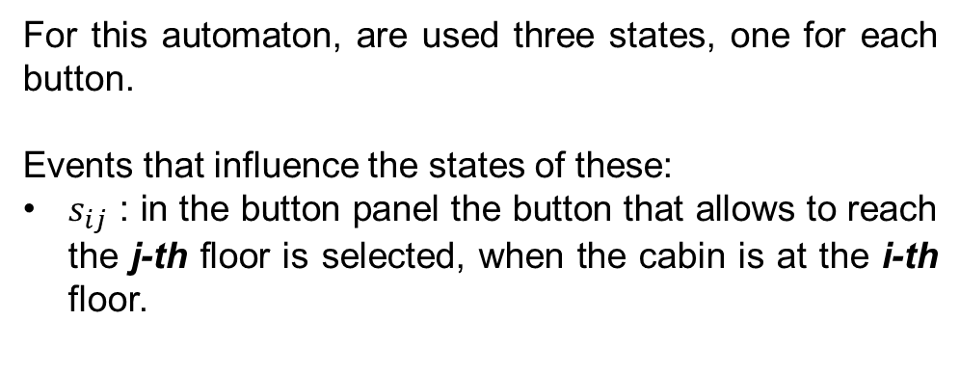
3-Floors elevator
THIRD STEP: MODELING OF THE COMPONENTS
Button panel
For this automaton, are used three states, one for each button.
Events that influence the states of these:
$s_{ij}$ : in the button panel the button that allows to reach the j-th floor is selected, when the cabin is at the i-th floor.
F3
up
down
F2
B1
s13
s12
s31
s21
F1
B3
s23
B2
s32

Slide 7
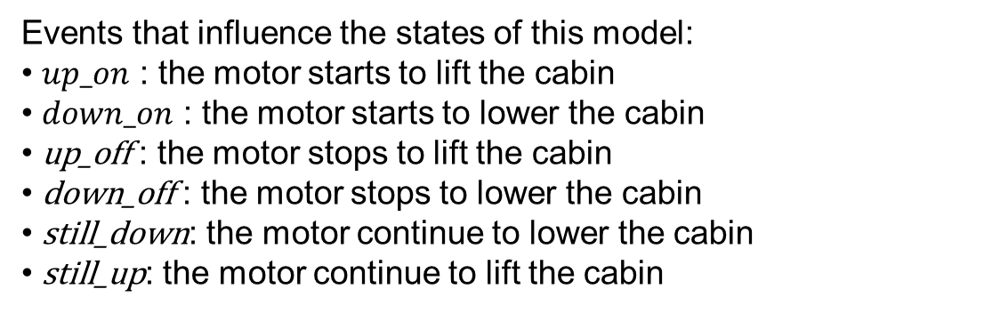
3-Floors elevator
THIRD STEP: MODELING OF THE COMPONENTS
Motor – Elevator motor
Events that influence the states of this model:
$up_on$ : the motor starts to lift the cabin
$down_on$ : the motor starts to lower the cabin
up_off : the motor stops to lift the cabin
down_off : the motor stops to lower the cabin
still_down: the motor continue to lower the cabin
still_up: the motor continue to lift the cabin
up
F3
down
Open / Closed
F2
still_down
still_up
downON
upON
Down
Off
Up
F1
downOFF
upOFF

Slide 8
3-Floors elevator
THIRD STEP: MODELING OF THE COMPONENTS
still_down: the motor continue to lower the cabin
still_up: the motor continue to lift the cabin
F3
up
The addition of these two events is necessary when the elevator has to pass through more than one floor consecutively.
They allow us to obtain controllability of the overall system.
down
Open / Closed
F2
still_down
still_up
downON
upON
Down
Off
Up
F1
downOFF
upOFF

Slide 9
3-Floors elevator
THIRD STEP: MODELING OF THE COMPONENTS
There are two different types of behaviours to be enforced.
The physical constraints: →
The elevator cannot go any lower than floor 1 or any higher than floor 3
Elevator must go up (down) if the motor is working upwards (downwards)
Button panel can receive a new command only when the previous one has been executed
The desired behaviour:
For each button panel command:
The motor must start and stop once
The elevator must reach the desired floor and then stop

Slide 10
3-Floors elevator
INDENTIFY CONSTRAINTS AND SPECIFICATIONS:
Similarly to before, two main approaches are possible.
Working directly on automata modeling single components
Working on the synchronous composition: possibly the synchronous composition among a few models
Let’s start by working on automata of the components.

Slide 11
3-Floors elevator
THIRD STEP: MODELING OF THE COMPONENTS
The elevator cannot go any lower than floor 1 or any higher than floor 3
PositionSensors
upON
downON
upON
downON
to2
to3
F1
F2
F3
to1
to2

Slide 12
3-Floors elevator
THIRD STEP: MODELING OF THE COMPONENTS
Elevator must go up (down) if the motor is working upwards (downwards)
Elevator motor
still_down
still_up
downON
upON
to1
to2
to3
to2
Down
Off
Up
downOFF
upOFF
It is not enough to model the physical constraint when the elevator is on the second floor, since it can go up and down. It’s necessary to add specific constraints.

Slide 13
3-Floors elevator
THIRD STEP: MODELING OF THE COMPONENTS
Elevator must go up if the motor is working upwards
UpConstraint
upON
to3
NoUp
Rise
to2
F2
still_up
F3.5
to3
F3
to2
upOFF
upOFF
upOFF

Slide 14
3-Floors elevator
THIRD STEP: MODELING OF THE COMPONENTS
Elevator must go down if the motor is working downwards
DownConstraint
downON
to3
NoDown
Lower
to2
F2
still_down
F1.5
to1
F1
to2
downOFF
downOFF
downOFF

Slide 15
3-Floors elevator
THIRD STEP: MODELING OF THE COMPONENTS
Button panel can receive a new command only when the previous one has been executed
Constraint1command
s12
s13
s21
s23
s31
s32
Listening
Busy
upOFF
downOFF

Slide 16
3-Floors elevator
FOURTH STEP: SPECIFICATION PHASE
For each button panel command, the elevator must reach the desired floor and then stop – boundary floor
Sp_{a1}
s21
s31
Else
GoF1
upON
downOFF
to1

Slide 17
3-Floors elevator
FOURTH STEP: SPECIFICATION PHASE
For each button panel command the elevator must reach the desired floor and then stop – case of an intermediate floor
Sp_{a2}
s12
s32
Off
GoF2
upOFF
downOFF
still_down
still_up
upOFF
downOFF
to2
On

Slide 18
3-Floors elevator
FOURTH STEP: SPECIFICATION PHASE
For each button panel command the elevator must reach the desired floor and then stop – boundary floor
Sp_{a3}
s13
s23
Else
GoF3
upOFF
downON
to3

Slide 19
3-Floors elevator
FOURTH STEP: SPECIFICATION PHASE
For each button panel command the motor must start and stop once
Sp_{a4}
s12
s13
s21
s23
s31
s32
Off
Go
upOFF
downOFF
downON
upON
On

Slide 20
3-Floors elevator
INDENTIFY CONSTRAINTS AND SPECIFICATIONS:
Similarly to before, two main approaches are possible.
Working directly on automata modeling single components
Working on the synchronous composition: possibly the synchronous composition among a few models
Let’s analyze the synchronous compositions.

Slide 21
3-Floors elevator
Position || Motor
Physical constraint
downON
upON
still_down
still_up
F1 | Down
F1 | Off
F1 | Up
downOFF
upOFF
to2
to1
to2
to1
to2
to1
downON
upON
still_down
still_up
F2 | Down
F2 | Off
F2 | Up
downOFF
upOFF
to3
to2
downON
to3
to2
to3
to2
upON
still_down
still_up
F3 | Down
F3 | Off
F3 | Up
downOFF
upOFF

Slide 22
3-Floors elevator
Phc1
F1 | Down
downOFF
F1 | Off
upON
F1 | Up
to1
F2 | StillDown
to1
upOFF
to2
still_down
F2 | Down
F2 | Down
downON
F2 | Off
upON
F2 | Up
F2 | Up
still_up
to2
to3
F2 | StillUp
downOFF
to3
F3 | Down
F3 | Off
F3 | Up
downON
upOFF

Slide 23
3-Floors elevator
These states have been added to represent the choice of stopping at the second floor or continuing to the next.
Phc1
F1 | Down
downOFF
F1 | Off
upON
F1 | Up
to1
F2 | StillDown
to1
upOFF
to2
still_down
F2 | Down
F2 | Down
downON
F2 | Off
upON
F2 | Up
F2 | Up
still_up
to2
to3
F2 | StillUp
downOFF
to3
F3 | Down
F3 | Off
F3 | Up
downON
upOFF

Slide 24
3-Floors elevator
Button Panel || Motor
Physical constraint
still_down
still_up
Down | B1
downOFF
Off | B1
upON
Up | B1
downON
upOFF
s12
still_down
s31
s13
s12
s31
s13
s12
still_up
s21
s21
s21
Down | B2
downOFF
Off | B2
upON
Up | B2
s31
s13
downON
upOFF
s23
s23
s23
s32
s32
s32
Down | B3
downOFF
Off | B3
upON
Up | B3
downON
upOFF
still_down
still_up

Slide 25
3-Floors elevator
Phc2 $≺$ Button Panel || Motor
Refined automaton:
still_down
still_up
Down | B1
downOFF
Off | B1
upON
Up | B1
downON
upOFF
still_down
s31
s13
s12
still_up
s21
Down | B2
downOFF
Off | B2
upON
Up | B2
downON
upOFF
s23
s32
Down | B3
downOFF
Off | B3
upON
Up | B3
downON
upOFF
still_down
still_up

Slide 26
3-Floors elevator
Button Panel || Motor
Unwanted behaviour
still_down
still_up
Down | B1
downOFF
Off | B1
upON
Up | B1
downON
upOFF
s12
still_down
s31
s13
s12
s31
s13
s12
still_up
s21
s21
s21
Down | B2
downOFF
Off | B2
upON
Up | B2
s31
s13
downON
upOFF
s23
s23
s23
s32
s32
s32
Down | B3
downOFF
Off | B3
upON
Up | B3
downON
upOFF
still_down
still_up

Slide 27
3-Floors elevator
Sp2 $≺$ Button Panel || Motor
Refined automaton:
still_down
Down | B1
downOFF
Off | B1
Up | B1
downON
s12
s31
s13
s12
s31
s13
s12
s21
s21
s21
Down | B2
downOFF
Off | B2
upON
Up | B2
s31
s13
downON
upOFF
s23
s23
s23
s32
s32
s32
Down | B3
Off | B3
upON
Up | B3
upOFF
still_up

Slide 28
3-Floors elevator
Pch2 || Sp2
Refined automaton:
still_down
Down | B1
downOFF
Off | B1
downON
s31
s13
s12
s21
Down | B2
downOFF
Off | B2
upON
Up | B2
downON
upOFF
s23
s32
Off | B3
upON
Up | B3
upOFF
still_up

Slide 29
3-Floors elevator
Button Panel || Position
Physical constraint
F1 | B1
to2
F2 | B1
to3
F3 | B1
to1
to2
s12
s31
s13
s12
s31
s13
s12
s21
s21
s21
F1 | B2
to2
F2 | B2
to3
F3 | B2
s31
s13
to1
to2
s23
s23
s23
s32
s32
s32
F1 | B3
to2
F2 | B3
to3
F3 | B3
to1
to2

Slide 30
3-Floors elevator
Phc3 $≺$ Button Panel || Position
Refined automaton:
F1 | B1
to2
F2 | B1
to3
F3 | B1
to1
to2
s12
s31
s21
F1 | B2
to2
F2 | B2
to3
F3 | B2
s13
to1
to2
s23
s32
F1 | B3
to2
F2 | B3
to3
F3 | B3
to1
to2

Slide 31
3-Floors elevator
Button Panel || Position
Unwanted behaviour
F1 | B1
to2
F2 | B1
to3
F3 | B1
to1
to2
s12
s31
s13
s12
s31
s13
s12
s21
s21
s21
F1 | B2
to2
F2 | B2
to3
F3 | B2
s31
s13
to1
to2
s23
s23
s23
s32
s32
s32
F1 | B3
to2
F2 | B3
to3
F3 | B3
to1
to2

Slide 32
3-Floors elevator
Sp3 $≺$ Button Panel || Position
Refined automaton:
F1 | B1
F2 | B1
F3 | B1
to1
to2
s12
s31
s13
s12
s31
s13
s12
s21
s21
s21
F1 | B2
to2
F2 | B2
F3 | B2
s31
s13
to2
s23
s23
s23
s32
s32
s32
F1 | B3
to2
F2 | B3
to3
F3 | B3

Slide 33
3-Floors elevator
Pch3 || Sp3
Refined automaton:
F1 | B1
F2 | B1
F3 | B1
to1
to2
s12
s31
s21
F1 | B2
to2
F2 | B2
F3 | B2
s13
to2
s23
s32
F1 | B3
to2
F2 | B3
to3
F3 | B3

Slide 34
3-Floors elevator
In the obtained automata, there are still undesired behaviors.
Through the synchronous composition of the models in pairs, it is not possible to eliminate the unwanted events.
A more adequate explanation is provided in the following slides.
Therefore, it is necessary to study the synchronous composition of all three models of our system.

Slide 35
3-Floors elevator
For example, we do not want the motor to activate immediately after it has turned off.
Phc1
F1 | Down
downOFF
F1 | Off
upON
F1 | Up
to1
F2 | StillDown
to1
upOFF
to2
still_down
F2 | Down
F2 | Down
downON
F2 | Off
upON
F2 | Up
F2 | Up
still_up
to2
to3
F2 | StillUp
downOFF
to3
F3 | Down
F3 | Off
F3 | Up
downON
upOFF

Slide 36
3-Floors elevator
For example, we do not want the motor to activate immediately after it has turned off.
Phc1
F1 | Down
downOFF
F1 | Off
upON
F1 | Up
to1
F2 | StillDown
to1
upOFF
to2
still_down
F2 | Down
F2 | Down
downON
F2 | Off
upON
F2 | Up
F2 | Up
still_up
to2
to3
F2 | StillUp
downOFF
to3
F3 | Down
F3 | Off
F3 | Up
downON
upOFF

Slide 37
3-Floors elevator
Phc1 || Phc2 || Sp2 || Phc3 || Sp3
Unwanted behaviour
Down_F1_B1
Off_F1_B1
Off_F1_B3
Up_F1_B3
downOFF
s13
upON
s12
Off_F1_B2
to1
to2
upON
Off_F2_B3
Up_F1_B2
s23
Up_F2_B3
upOFF
Down_F2_B1
upON
downON
to2
upOFF
downOFF
still_up
still_down
Up_F2_B2
Off_F2_B2
Down_F2_B2
downOFF
Down_F2_B1
to2
upON
Up_F2_B3
downON
Down_F3_B2
Off_F2_B1
s21
to2
downON
to3
Off_F3_B2
s32
Down_F3_B1
downON
Off_F3_B1
s31
Off_F3_B3
upOFF
Up_F3_B3

Slide 38
3-Floors elevator
TotalSystem1 $≺$ Ph1 || PhSp2 || Ph3 || Sp3
Refined automaton:
Down_F1_B1
Off_F1_B1
Off_F1_B3
Up_F1_B3
downOFF
s13
upON
s12
Off_F1_B2
to1
to2
upON
Off_F2_B3
Down_F2_B1
Up_F1_B2
s23
Up_F2_B3
downON
to2
upOFF
downOFF
still_up
still_down
Up_F2_B2
Off_F2_B2
Down_F2_B2
Down_F2_B1
to2
upON
Up_F2_B3
Down_F3_B2
Off_F2_B1
s21
to2
downON
to3
Off_F3_B2
s32
Down_F3_B1
downON
Off_F3_B1
s31
Off_F3_B3
upOFF
Up_F3_B3

Slide 39
3-Floors elevator
INDENTIFY SPECIFICATIONS of INTEGRATED CASE:
The model of the 3-floors elevator must be integrated with the door motor.
The desired behaviour:
Doors can be open only if the elevator motor is off.
Elevator motor can turn on only if the doors are close.

Slide 40
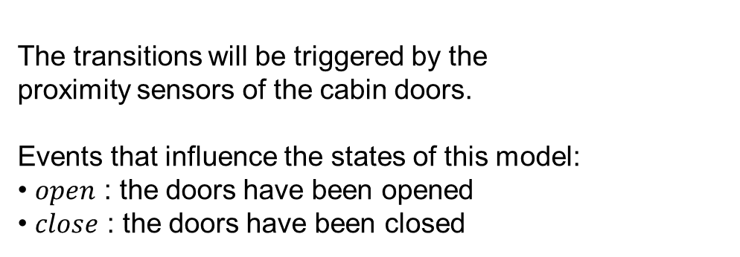
3-Floors elevator
INDENTIFY SPECIFICATIONS of INTEGRATED CASE:
Let's consider a simple model, a manually-actuated door.
F2
up
Doors
down
open
Closed
Open
Open / Closed
F1
close
The transitions will be triggered by the
proximity sensors of the cabin doors.
Events that influence the states of this model:
$open$ : the doors have been opened
$close$ : the doors have been closed
F1

Slide 41
3-Floors elevator
INDENTIFY SPECIFICATIONS of INTEGRATED CASE:
Similarly to before, two main approaches are possible.
Working directly on automata modeling single components
Working on the synchronous composition: possibly the synchronous composition among a few models
Let’s start by working on automata of the components.

Slide 42
3-Floors elevator
INDENTIFY SPECIFICATIONS of INTEGRATED CASE:
Doors can be open only if the elevator motor is off.
Elevator motor
open
still_down
downON
upON
still_up
Down
Off
Up
to1
to2
downOFF
upOFF
to3
to2

Slide 43
3-Floors elevator
INDENTIFY SPECIFICATIONS of INTEGRATED CASE:
Elevator motor can turn on only if the doors are close.
Doors
upON
open
Closed
Open
close
downON

Slide 44
3-Floors elevator
INDENTIFY SPECIFICATIONS of INTEGRATED CASE:
Similarly to before, two main approaches are possible.
Working directly on automata modeling single components
Working on the synchronous composition: possibly the synchronous composition among a few models
Let’s analyze the synchronous compositions.

Slide 45
Realistic door model
ElevatorMotor || Doors
Unwanted behaviour
still_down
still_up
downON
upON
Closed | Down
Closed | Off
Closed | Up
downOFF
upOFF
open
close
open
close
open
close
downON
upON
Open | Down
Open | Off
Open | Up
downOFF
upOFF
still_down
still_up

Slide 46
Realistic door model
Sp4 $≺$ ElevatorMotor || Doors
Refined automaton:
still_down
still_up
downON
upON
Closed | Down
Closed | Off
Closed | Up
downOFF
upOFF
open
close
Open | Off

Slide 47
3-Floors elevator
TotalSystem1 $≺$ Ph1 || PhSp2 || Ph3 || Sp3
Down_F1_B1
Off_F1_B1
Off_F1_B3
Up_F1_B3
downOFF
s13
upON
s12
Off_F1_B2
to1
to2
upON
Off_F2_B3
Down_F2_B1
Up_F1_B2
s23
Up_F2_B3
Let's zoom in on these three states to see how the doors interact with the rest of the system.
downON
to2
upOFF
downOFF
still_up
still_down
Up_F2_B2
Off_F2_B2
Down_F2_B2
Down_F2_B1
to2
upON
Up_F2_B3
Down_F3_B2
Off_F2_B1
s21
to2
downON
to3
Off_F3_B2
s32
Down_F3_B1
downON
Off_F3_B1
s31
Off_F3_B3
upOFF
Up_F3_B3

Slide 48
3-Floors elevator
TotalSystem $≺$ TotalSystem1 || Sp4
Off_F1_B1_Open
s13
s12
close
open
Off_F1_B1_Closed
Off_F1_B3_Closed
downOFF
s13
upON
s12
Off_F1_B2_Closed
open
close
close
Off_F1_B3_Open
upON
Off_F1_B2_Open
open
The same behavior is observed when the elevator is on the second and third floors, but always with the motor off.

Slide 49

3rd model
N-Floors elevator

Slide 50
N-Floors elevator
THIRD STEP: MODELING OF THE COMPONENTS
This model is a direct extension of the 3-Floors elevator, using the same components. “Motor” and “Door” automata remain unchanged:
Motor
Door
still_down
still_up
downON
upON
open
Down
Off
Up
Closed
Open
downOFF
upOFF
close

Slide 51
N-Floors elevator
THIRD STEP: MODELING OF THE COMPONENTS
“Position” and “Button panel” automata are modified as follows:
Position
to2
to3
to4
to5
to6
F1
F2
F3
F4
F5
to1
to2
to3
to4
to5
B1
Button panel
B2
B5
B3
B4

Slide 52
N-Floors elevator
INDENTIFY CONSTRAINTS AND SPECIFICATIONS:
Due to the growing size of the automata, the case of a N-floor elevator will be treated using only one method.
Working directly on automata modeling single components
.

Slide 53
N-Floors elevator
THIRD STEP: MODELING OF THE COMPONENTS
The elevator cannot go any lower than floor 1 or any higher than the last floor
PositionSensors
upON
downON
upON
downON
upON
downON
upON
downON
to2
to3
to4
to5
F1
F2
F3
F4
Last
to1
to2
to3
to4

Slide 54
N-Floors elevator
THIRD STEP: MODELING OF THE COMPONENTS
Elevator must go up (down) if the motor is working upwards (downwards)
Elevator motor
still_down
still_up
open
downON
upON
to1
to2
…
to(Last-1)
to3
to2
…
toLast
Down
Off
Up
downOFF
upOFF
It is not enough to model the physical constraint when the elevator is at the intermediate floor, since it can go up and down. It’s necessary to add specific constraints.

Slide 55
N-Floors elevator
THIRD STEP: MODELING OF THE COMPONENTS
Elevator must go up if the motor is working upwards
UpConstraint
toLast
upON
to3
NoUp
Rise
to2
F2
F3
F3
FLast
still_up
to3
to2
to3
…
to(Last-1)
upOFF
upOFF
upOFF
upOFF

Slide 56
N-Floors elevator
THIRD STEP: MODELING OF THE COMPONENTS
Elevator must go up if the motor is working upwards
DownConstraint
to1
downON
to(Last-2)
NoDown
Lower
FL-1
FL-1.5
FL-2
F1
to2
to3
…
to(Last-1)
downOFF
to(Last-1)
still_down
to(Last-2)
downOFF
downOFF
downOFF

Slide 57
N-Floors elevator
FOURTH STEP: SPECIFICATION PHASE
For each button panel command the elevator must reach the desired floor and then stop – boundary floor
Sp1
s21
s31
….
Else
GoF1
upON
downOFF
to1

Slide 58
N-Floors elevator
FOURTH STEP: SPECIFICATION PHASE
For each button panel command the elevator must reach the desired floor and then stop – case of an intermediate floor, N in range [2, Last-1]
SpN
s1N
s3N
…
Off
GoFN
upOFF
downOFF
still_up
still_down
still_up
still_down
upOFF
downOFF
toN
On

Slide 59
N-Floors elevator
FOURTH STEP: SPECIFICATION PHASE
For each button panel command the elevator must reach the desired floor and then stop – boundary floor
SpLast
s1Last
s2Last
….
Else
GoFLast
upOFF
downON
toLast

Slide 60
N-Floors elevator
FOURTH STEP: SPECIFICATION PHASE
For each button panel command the motor must start and stop once
SpLast+1
this notation includes all events of the button panel
Off
all sxy
Go
upOFF
downOFF
downON
upON
On

Slide 61
N-Floors elevator
FOURTH STEP: SPECIFICATION PHASE
Elevator motor can turn on only if the doors are close.
Doors
upON
open
Closed
Open
close
downON

Slide 62
REALISTIC DOOR MODEL
ELEVATOR MODEL’S EXTENSION #2:

Slide 63
Realistic door model
Before:
Manually moved door
modeled only a sensor able to recognize the door’s position.
Realistic model:
Automatic door, the behavior is controllable
Elevator door closing stops in case of obstruction

Slide 64
Realistic door model
FIRST & SECOND STEPS: OUTLINE MODULAR SYSTEM COMPONENTS
SENSORS:
DOOR POSITION SENSOR:
“Open doors” proximity switch
“Closed doors” proximity switch
OBSTRUCTION SENSOR:
A photocell capable of detecting obstacles in the door’s way
ACTUATORS:
DOOR WINGS’ MOTOR :
This motor is used to open and close the door wings

Slide 65
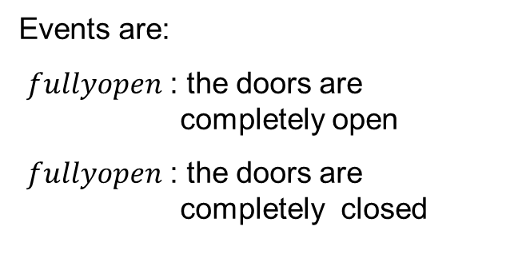
Realistic door model
THIRD STEP: MODELING OF THE COMPONENTS
The sensors of the door can be modeled with a 2-state automaton.
The transitions will be triggered by the proximity sensors of the cabin doors.
Events are:
$fullyopen$ : the doors are completely open
$fullyopen$ : the doors are completely closed
Door
fullyopen
fullyopen
Closed
Open
fullyclosed
Note that while the doors are closing, until the sensor recognizes the doors fully closed, the current state is ‘Open’. Same can be said about ‘Closed’ while opening.

Slide 66
Realistic door model
THIRD STEP: MODELING OF THE COMPONENTS
The sensors of the door can be modeled with a 2-state automaton.
The transitions will be triggered by the proximity sensors of the cabin doors.
Door
fullyopen
fullyopen
necessary in case an object is detected while closing, to allow the complete opening of the doors
Closed
Open
fullyclosed

Slide 67
Realistic door model
THIRD STEP: MODELING OF THE COMPONENTS
The obstruction sensor is modeled using two states and two events.
objectIN : the sensor signals when the photocell changes its state from free to obstructed
objectOUT : in this case the event represents the photocell going from obstructed to free
Obstruction sensor
objectIN
Free
Obstr
objectOUT

Slide 68
Realistic door model
THIRD STEP: MODELING OF THE COMPONENTS
Door’s Motor
The motor is modeled through a 3-state automaton, the active condition has been divided in Closing and Opening.
closeOn, openON, closeOFF, openOFF events represent the start or end of an action.
closeToOpen signals a shift in the behaviour, necessary when an obstacle is between the doors.
closeON
openON
Closing
Off
Opening
closeOFF
openOFF
closeToOpen

Slide 69
Realistic door model
INDENTIFY CONSTRAINTS AND SPECIFICATIONS:
The physical constraints of the system must be fulfilled:
Doors can be fully open only if the motor opened them.
Doors can be fully closed only if the motor closed them.
An object can obstruct the doors if and only if the doors are not shut.
Furthermore, the desired behaviour of the system is the following:
If something is detected between the doors, the doors must be open fully even if the object is immediately removed, for security reasons.
Doors can close only if the photocell state is free.
Movements must be complete: motor is turned off only if the doors are fully open or shut.

Slide 70
Realistic door model
INDENTIFY CONSTRAINTS AND SPECIFICATIONS:
Similarly to before, two main approaches are possible.
Working directly on automata modeling single components
Working on the synchronous composition: possibly the synchronous composition among a few models
Let’s start by working on automata of the components.

Slide 71
Realistic door model
THIRD STEP: MODELING OF THE COMPONENTS
Doors can be fully open only if the motor opened them.
Doors can be fully closed only if the motor closed them.
Door’s Motor (DMot)
fullyclosed
fullyopen
closeON
openON
Closing
Off
Opening
closeOFF
openOFF
closeToOpen

Slide 72
Realistic door model
THIRD STEP: MODELING OF THE COMPONENTS
An object can obstruct the doors only if the doors are not shut
Constraint (Con)
closeToOpen
closeToOpen
objectIN
openON
Shut
NotShut
fullyclosed

Slide 73
Realistic door model
THIRD STEP: MODELING OF THE COMPONENTS
Doors can close only if no object is between them
Obstruction sensor (Ob)
objectIN
Free
Obstr
objectOUT
fullyclosed

Slide 74
Realistic door model
THIRD STEP: MODELING OF THE COMPONENTS
There must be a 1 to 1 correspondence of fullyopen signal with an opening command. Fullyopen cannot repeat independently.
Constraint(Con2)
openON
closeToOpen
NotOpen
Open
fullyopen

Slide 75
Realistic door model
FOURTH STEP: SPECIFICATION PHASE
Doors can close only if the photocell state is free.
Obstruction sensor (Spd_{a1})
closeON
objectIN
Free
Obstr
closeOFF
objectOUT

Slide 76
Realistic door model
FOURTH STEP: SPECIFICATION PHASE
If something is detected between the doors, the motor cannot turn off before opening the door
OpenAfterObj (Spd_{a2})
objectIN
fullyclosed
closeON
objectIN
0
1
2
objectIN
closeOFF
fullyclosed
closeToOpen

Slide 77
Realistic door model
FOURTH STEP: SPECIFICATION PHASE
If something is detected between the doors, the motor cannot turn off before opening the door
OpenAfterObj (Spd_{a2})
objectIN
fullyclosed
closeON
objectIN
0
1
2
fullyclosed represents the limit case of a thin object sliding between the doors right before they close completely
objectIN
closeOFF
fullyclosed
closeToOpen

Slide 78
Realistic door model
FOURTH STEP: SPECIFICATION PHASE
Movements must be complete:
Opening is turned off only after the doors are fully open, then the closing can start
Same with closing
Door (Spd_{a3})
fullyopen
fullyopen
Closed
Open
fullyclosed
openOFF
closeOFF
openON
closeON

Slide 79
Realistic door model
FOURTH STEP: SPECIFICATION PHASE
After each time the doors are fully open the motor has to stop.
Spd_{a4}
fullyopen
Sp0
Sp1
openOFF

Slide 80
Realistic door model
INDENTIFY CONSTRAINTS AND SPECIFICATIONS:
Similarly to before, two main approaches are possible.
Working directly on automata modeling single components
Working on the synchronous composition: possibly the synchronous composition among a few models
Let’s analyze the synchronous compositions.

Slide 81
Realistic door model
DoorSensor || ObstructionSensor
Physical constraint
fullyclosed
Closed-Free
Open-Free
fullyopen
objectIN
objectOUT
objectIN
objectOUT
fullyopen
Closed-Obstr
fullyclosed
Open-Obstr
fullyopen
Doors can close only if no object is between them
fullyopen

Slide 82
Realistic door model
PhCd1 $≺$ DoorSensor || ObstructionSensor
Refined automaton:
fullyclosed
Closed-Free
Open-Free
fullyopen
objectIN
objectOUT
objectIN
objectOUT
fullyopen
Closed-Obstr
Open-Obstr
fullyopen
fullyopen

Slide 83
Realistic door model
DoorSensor || DoorMotor
Physical constraint
Off-Closed
closeON
openOFF
closeOFF
openON
Closing-Closed
Opening-Closed
closeToOpen
fullyclosed
fullyopen
fullyclosed
fullyopen
fullyclosed
fullyopen
Closing-Open
closeToOpen
Opening-Open
closeON
openOFF
fullyopen
Off-Open
openON
fullyopen
closeOFF
fullyopen

Slide 84
Realistic door model
PhCd2 $≺$ DoorSensor || DoorMotor
Refined automaton:
Off-Closed
closeON
openOFF
closeOFF
openON
Closing-Closed
Opening-Closed
closeToOpen
fullyclosed
fullyopen
Closing-Open
closeToOpen
Opening-Open
closeON
openOFF
closeOFF
Off-Open
openON

Slide 85
Realistic door model
DoorSensor || DoorMotor
Unwanted behaviour
Off-Closed
closeON
openOFF
closeOFF
openON
Closing-Closed
Opening-Closed
closeToOpen
fullyclosed
fullyopen
fullyclosed
fullyopen
fullyclosed
fullyopen
Closing-Open
closeToOpen
Opening-Open
closeON
openOFF
fullyopen
Off-Open
openON
fullyopen
closeOFF
fullyopen

Slide 86
Realistic door model
Spd2 $≺$ DoorSensor || DoorMotor
Refined automaton:
Off-Closed
closeOFF
openON
Closing-Closed
Opening-Closed
fullyclosed
fullyopen
fullyclosed
fullyopen
fullyclosed
fullyopen
Closing-Open
closeToOpen
Opening-Open
closeON
openOFF
fullyopen
Off-Open
fullyopen
fullyopen

Slide 87
Realistic door model
State added to ensure that openOFF is executed after fullyopen
Phcd2 || Spd2
Off-Closed
closeOFF
openON
Closing-Closed
Opening-Closed
fullyclosed
fullyopen
Closing-Open
Opening
Opening-Open
closeToOpen
fullyopen
closeON
openOFF
Off-Open

Slide 88
Realistic door model
ObstructionSensor || DoorMotor
Unwanted behaviour
Off-Free
closeON
openOFF
closeOFF
openON
Closing-Free
Opening-Free
closeToOpen
objectOUT
objectIN
objectOUT
objectIN
objectOUT
objectIN
Closing-Obstr
closeToOpen
Opening-Obstr
closeON
openOFF
closeOFF
Off-Obstr
openON

Slide 89
Realistic door model
Spd3
Off-Free
closeON
openOFF
closeOFF
openON
Closing-Free
Opening-Free
objectOUT
objectIN
objectIN
objectOUT
objectIN
Closing-Obstr
closeToOpen
Opening-Obstr
openOFF
objectOUT
objectIN
Off-Obstr
Closing
closeToOpen

Slide 90
Realistic door model
State added to memorize the transit of an object in the current closing operation
Spd3
Off-Free
closeON
openOFF
closeOFF
openON
Closing-Free
Opening-Free
objectOUT
objectIN
objectIN
objectOUT
objectIN
Closing-Obstr
closeToOpen
Opening-Obstr
openOFF
objectOUT
objectIN
Off-Obstr
Closing
closeToOpen

Slide 91
Realistic door model
objectIN
objectOUT
PhCd1||PhCd2||Spd2||Spd3
0
closeOFF
4
objectIN
objectOUT
fullyclosed
objectOUT
openON
1
fullyopen
5
closeON
8
11
objectIN
objectIN
objectOUT
objectIN
openOFF
objectOUT
openOFF
2
6
closeToOpen
9
12
fullyopen
objectIN
closeToOpen
objectIN
objectOUT
fullyopen
objectOUT
fullyopen
3
7
10
13
objectIN
fullyclosed
closeToOpen
objectIN
objectOUT

Slide 92
Realistic door model
In the automaton obtained from the syncronous composition of PhCd1||Spd1||Spd2 are present unfeasible behaviours.
They result from the interaction between the three modules, therefore cannot be prevented acting only on the syncronous composition between pairs of modules.
Unfeasible behaviour: object detected between the doors when they are fully closed (equal to Con)

Slide 93
Realistic door model
DoorAut = PhCd1||PhCd2||Spd2||Spd3||Con
= DSens||DMot||Ob||Con||Con2||Spd_{a1}||Spd_{a2}||Spd_{a3}||Spd_{a4}
0
closeOFF
4
fullyclosed
objectOUT
openON
1
fullyopen
5
closeON
8
11
objectIN
objectIN
objectOUT
objectIN
openOFF
objectOUT
openOFF
2
6
closeToOpen
9
12
fullyopen
objectIN
closeToOpen
objectIN
objectOUT
fullyopen
objectOUT
fullyopen
3
7
10
13
fullyclosed
closeToOpen
objectIN

Slide 94
Realistic door model
INDENTIFY SPECIFICATIONS of INTEGRATED CASE:
The model of the realistic door must be integrated with the elevator motor and the floor sensor.
Doors can open only if the elevator motor is off.
Elevator motor can turn on only if the doors are shut.
Elevator motor can turn on only if the door motor is off.

Slide 95
Realistic door model
INDENTIFY SPECIFICATIONS of INTEGRATED CASE:
Similarly to before, two main approaches are possible.
Working directly on automata modeling single components
Working on the synchronous composition: possibly the synchronous composition among a few models
Let’s start by working on automata of the components.

Slide 96
Realistic door model
INDENTIFY SPECIFICATIONS of INTEGRATED CASE:
Doors can open only if the elevator motor is off.
Elevator motor Sp_{int1}
openON
fullyopen
downON
upON
to2
Down
Off
Up
to1
downOFF
upOFF

Slide 97
Realistic door model
INDENTIFY SPECIFICATIONS of INTEGRATED CASE:
Elevator motor can turn on only the door motor is off.
Door motor (Sp_{int2})
fullyopen
fullyclosed
objectOUT
objectOUT
closeON
openON
Closing
Off
Opening
closeOFF
openOFF
upON
downON
closeToOpen

Slide 98
Realistic door model
INDENTIFY SPECIFICATIONS of INTEGRATED CASE:
Elevator motor can turn on only if the doors are shut.
Door (Sp_{int3})
upON
downON
fullyopen
fullyopen
Closed
Open
closeON
fullyclosed
openOFF
closeOFF

Slide 99
Realistic door model
INDENTIFY SPECIFICATIONS of INTEGRATED CASE:
Similarly to before, two main approaches are possible.
Working directly on automata modeling single components
Working on the synchronous composition: possibly the synchronous composition among a few models
Let’s analyze the synchronous compositions.

Slide 100
Realistic door model
DoorMotor || ElevatorMotor
Unwanted behaviour
openOFF
closeON
Opening-Up
Off-Up
Closing-Up
openON
closeOFF
upON
upOFF
upON
upOFF
upON
upOFF
Opening-Off
openOFF
Off-Off
closeON
Closing-Off
openON
closeOFF
downOFF
downON
downOFF
downON
downOFF
downON
Opening-Down
openOFF
Off-Down
closeON
Closing-Down
openON
closeOFF
closeToOpen

Slide 101
Realistic door model
Spi1 $≺$ DoorMotor || ElevatorMotor
Refined automaton :
Off-Up
upON
upOFF
Opening-Off
openOFF
Off-Off
closeON
Closing-Off
openON
closeOFF
downOFF
downON
Off-Down
closeToOpen

Slide 102
Realistic door model
DoorPosition || ElevatorMotor
Unwanted behaviour
upOFF
downON
Closed-Up
Closed-Off
Closed-Down
upON
downOFF
fullyclosed
fullyopen
fullyclosed
fullyopen
fullyclosed
fullyopen
upOFF
downOFF
Open-Up
Open-Off
Open-Down
upON
downON
fullyopen
fullyopen
fullyopen

Slide 103
Realistic door model
Spi2 $≺$ DoorPosition || ElevatorMotor
Refined automaton :
upOFF
downON
Closed-Up
Closed-Off
Closed-Down
upON
downOFF
fullyclosed
fullyopen
Open-Off
fullyopen

Slide 104
Realistic door model
FINAL RESULT
Spi1||Spi2||DoorAut||SP1 = Sp_{int1} ||Sp_{int2} ||Sp_{int3} ||DoorAut||Position2||Spb2
Automatic Door
The state is a representation of the behaviour showed in slide 93
openON
closeOFF
F1 - Closed - Down
F1 - Closed - Off
F1 - Closed - Up
downOFF
upON
to1
to2
F2 - Closed - Down
F2 - Closed - Off
F2 - Closed - Up
downON
upOFF
openON
closeOFF
Automatic Door

